Slide 1
Cradle Races
Tests: Cradling, Conditioning, Ground Balls, Passing
Explanation: Any number of cradle race activities by individual players. Make this a competition and add variables. The whole team can be divided up into a number of smaller teams of four to six players..
Variations: 1) Race to a cone while cradling and back; 2) Race to a cone while cradling both hands strong side and returning cradling both hands weak side; 3) Race to a cone cradling one handed strong side and return cradling one handed weak side; 4) Race through serpentine cones and return, passing the ball the next in line, who continues; 5) Race through serpentine cones and return, rolling a ground ball to the next in line, who scoops the ground ball and continues; 6) Do one of these options and add a dodge at the whistle. Options are endless.
A Little Something Extra: 1) Have players begin the race in the prone position or facing away from the coaches; 2) Have players kick a ground ball or “goose it” forward with their stick; 3) Have players shoot on a goal

Slide 2
Back to Back Drill
Tests: Ground Balls, Conditioning, Effort, Passing
Explanation: Two players stand back to back, with a ball rested between them. On the first whistle, the players try to back up and get themselves over the ball and in a position to scoop it. On the second whistle, the players try to scoop the ball or kick or “goose” it away from their opponent. Focus on having the “winner” make a C cut away from pressure, with his stick in his outside hand. Upon completing the C cut, have the “winner” make an outlet pass to a third player or a coach.
Variation: 1) At older levels, coaches can work with two offensive players playing “man ball” vs. a defensive player in the same drill. One offensive player calls “man” and legally pushes the defender out of the way; one offensive player calls “ball” and scoops the ball, “C cuts”— it looks just like it sounds— to the outside, and says “release.” “Release” is the call to notify the first offensive player to disengage from the defender and quickly move to space for an outlet pass. The player with the ball should then feed this releasing player. Reinforce quick passing off a ground ball. For players who don’t see this, show them in one or two reps the speed and distance of a pass vs. just running.
Error Correction: Get in an athletic stance, knees bent, body lowered, NOT bending over at the waist. Show players, especially younger ones, how much stronger their legs are than their arms.

Slide 3

1 v 1, The Army Way (Courtesy of LaxCoachMike)
Tests: Ground Balls, Passing, Catching, Effort
Explanation: Two players begin shoulder to shoulder. On the whistle, the designated defender (D) circles the closest cone, while the designated offensive player (A) circles the deeper cone. A nearby coach passes (or rolls a ground ball) to the offensive player. The defensive player come in to play defense on the move, takes a good defensive position with his body, stick out front (and using poke and lift checks only). Think and reinforce that “stick leads” (i.e. the stick is always in front). Play to a goal or a defensive stop. (On a defensive stop, have the defender clear the ball up the field with the offensive player riding him.) Vary the locations of the cones. This can be run at multiple locations on the field. Try it one group on a wing and one group around X. Work on footwork and patience by the defenders; time is on their side. Minimize checks. Just resting a defensive stick on an offensive player’s hands is disrupting.
Variation: 1) At older levels, coaches can work with two offensive players playing “man ball” vs. a defensive player in the same drill. One offensive player calls “man” and legally pushes the defender out of the way; one offensive player calls “ball” and scoops the ball, banana cuts to the outside and says “release.” “Release” is the call to notify the first offensive player to disengage from the defender and move for an outlet pass. The player with the ball should then feed this releasing player.
G
D
A
Coach

Slide 4
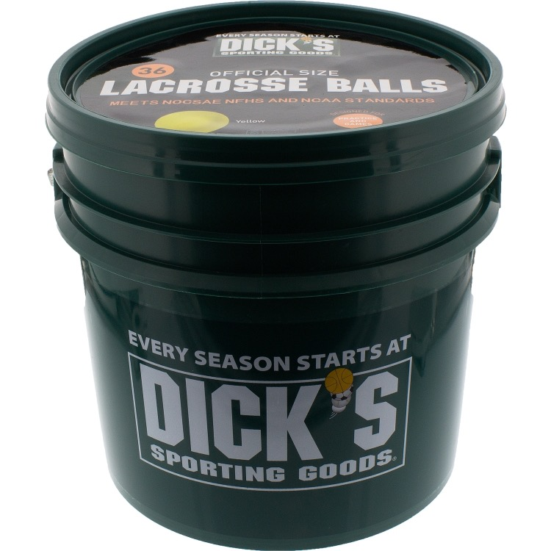
Canadian 2 v 2 Groundballs
Tests: Ground Balls, Passing, Catching, Defense, Movement
Explanation: Coach is located at the top of the attack zone with balls. Two lines of players will be behind the goal, with a goalie in the cage. The coach will roll out a ball and the first players in each line will go after it. Players play to a shot, a save, or a clear. Focus on player movement and communication. Run this drill fast (10-15 seconds per) and give players lots of reps. Have the goalie clear all saves (or goals) to defensive players and have offensive players ride the defenders to the mid-line.
Variation: 1) Coach can yell “Plus 1” for a particular side and an additional player join the drill.
Coach
A
B
A
B
A
B
A
B

Slide 5
Groundball Crease Scramble
Tests: Ground Balls, Close Quarter Shooting
Explanation: Coach is located at the back of the goal with a bucket of balls. A group of players will line up approximately five yards behind the crease around X. Coach will start watch and give players one minute to run as many reps as possible. Coach will roll a ball and the first player in line will scoop it, run the crease, get above Goal Line Extended (GLE) and shoot a wrist shot into the far corner of the goal. This player will then sprint the rest of the way around the goal to the back of the player line. Coach will roll out a ball to the next player and the drill continues for a minute. At one minute count the goals. Run the drill both clockwise and counterclockwise for players to work on left and right hands. This is a good pre-game warm-up drill.
Variation: 1) Above GLE, have players throw a quick shoulder fake and then execute the wrist shot to the far corner of the goal; 2) Add defenders waiting at one side or the other at GLE to pressure the attacking player.
Error Correction: Many players will wind up and blast the ball at the goal. This isn’t a realistic shot. Coaches should show and then reward players who execute a quicker wrist shot. Aim should be for around 18” inside the far pipe and 18” above the ground. This gives the shooter room for error.

Slide 6
Three Pressure Ground Balls (Courtesy of US Lacrosse)
Tests: Ground Balls, Communication, Shooting
Explanation: Divide the field into thirds. On the first third, run “Advantage GB,” where a coach rolls a ball to one side or the other, creating an advantage, winner shoots and looser must cut off the shooter and play defense. On the middle third, run “Face-Off Wing GB,” where a ground ball comes in from the wing and players fight for possession, winner executes a C cut and passes the ball to the coach. On the final third, run “Crease Crunch,” where a coach rolls a ball in for a 2v2 groundball with a quick shot on goal.
Variation: 1) Add a long pole to a defender to force offense to be sharp; 2) Vary locations of ground balls, throw most close, but throw a few 10 yards away. For realism and not simply letting the fastest player win, throw most ground balls relatively close to the players.
“Crease Crunch” Drill
Face-Off Wing GB Drill
Advantage GB Drill
A
A
A
A
Coach
Balls
A
Coach
Balls
Coach
Balls
A
A
A
D
D
D
D
D
A
D
D
D
D
M1
M2
M1
M2
M1
M2

Slide 7
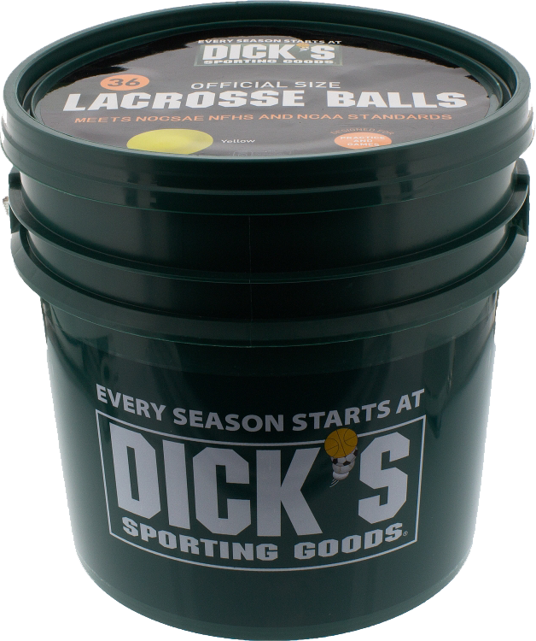
Ground Ball Bucket
Tests: Ground Balls
Explanation: Have a coach with a bucket of balls in the center with players to the left and right. Put a minute on the clock. Very quickly, roll balls left and right. The first players in each line, run out, scoop the ground ball, and roll to the outside. Players drop the ball next to the coach and return to the line. Time the drill at a minute and see how many groundballs each team can get. Then switch sides. Players should be scooping their ground balls with their sticks to the outside.
Variation: 1) Add a pass to an outlet player; 2) Add a third line and run a 2v1 ground ball drill with a pass or a pick.
Coach
B1
A1
B2
A2
B3
A3

Slide 8
Simple Partner Passing
Tests: Passing, Catching, and Movement
Explanation: Start with two easy options. 1) Have two partners standing around 10 yards from one another. Focus on the basics: Bottom hand away from the body; stick in an imaginary box above the shoulder; upper hand mid-way on the shaft; basic push (top hand) and pull (lower hand). Throwing man should step toward his target to pass. Receiving player should call for the ball (e.g. “Here’s your help!”) and catch the ball with soft hands, cushioning its arrival, as if it were an egg. Don’t stab at the ball. 2) Have two partners, one standing 10 to 15 yards away and one on his knees. The kneeling player is on one knee with his front (stepping) foot planted forward, pointing at his target. The kneeling player throws from his knees to his standing partner, focusing on rotating his torso and having his hands away from his body. Throw overhand. Standing partner rolls passes back.
Better Still: Actively pass. 1) Two partners running (they will likely jog to be honest) about 10 yards apart from a spot to a spot. Do this any number of ways: 1) outside hand pass to outside hand; or 2) outside hand pass to inside hand, switch hands and return the pass with the outside hand. Teach hip and shoulder rotation. Talk with “Here’s your help ____________.”
Error Correction: Players need to focus on pointing their front elbow where they want the pass to go and then throwing the pass overhand, snapping wrists, and not lobbing the ball. Focus players on passing correctly and on target and try to get away from lob passes.
Also, in active passing drills, ensure the receiving player is running just ahead of his passer. If the receiving player is lagging, he will have to sprint to get up ahead of his partner.

Slide 9
3 Man 2 Balls
Tests: Passing, Catching, Conditioning
Explanation: This is a self-explanatory passing and catching drill. Players are positioned in a triangle. Feeding players have ample balls at their feet—have them practicing scooping properly. Player 1, moving his feet, will catch a pass from Player 2 and return the pass to Player 2. Player 1 will then look to Player 3 and do the same thing. Run this for 30 seconds per player and challenge them to count their passes and catches. Watch to ensure proper form and overhead passes. For inexperienced players, work on confidence and form. For more advanced players, work on passing and catching with their outside hands. Create an environment where failing with one’s
“weak” hand is okay! This is practice and about improvement. Have players call for the ball.
Variations: 1) Place balls a few feet from Players 2 and 3 so they have to move to pick up a ground ball before passing; 2) Have Player 1 running around a cone (conditioning) before receiving his passes.
1
2
3

Slide 10
3 v 2 (or 3 v 1) Zombie
Tests: Passing, Catching, Conditioning
Explanation: Same passing triangle as in 3 Man 2 Balls. Place offensive players (1, 2, 3) in a triangle with one (D) or two (D, D) defensive players in the middle. Players work around their area of the triangle passing and catching (w/outside hands) while D pressures the ball. Have D play without sticks to start and work on their footwork.
D (with or w/o sticks) should be vocal—use a simple “I got ball!”--and properly positioning themselves to play defense; have their sticks up to bat down poor passes.
Variations: 1) Give the offensive players an area that they have to stay in to pass and catch; 2) Give the offensive players the ability to move around to “get open” for a pass and have defensive pressure more pronounced (and with sticks).
1
2
D
3

Slide 11
Monkey in the Middle
Tests: Passing, Catching, Conditioning
Explanation: Two players (Player 1 and Player 3) pass (or roll a ground ball) to a player in the middle (Player 2). Player 1 receives the pass (or ground ball) and returns it to his feeder. Always use outside hand. Run this drill with players relatively close together at first so they gain confidence with their passing accurately. Run for high reps, around 30 seconds, and switch roles. Have players using both hands. For younger players, they may have to cradle before throwing. For older players, have them catch and pass quickly, without cradling.
Variation: 1) Have Player 2 passing and catching on the move while running figure 8s around his feeders. Player 2 will pass and catch on the run, still using his outside hand (see below); 2) Players 1 and 3 can move to a nearby cone while cradling a ball before feeding a moving Player 2.
1
2
3
OR

Slide 12
Notre Dame Pendulum Passing (Courtesy of Notre Dame Lacrosse)
Tests: Passing, Catching, Conditioning
Explanation: Players 2 and 3 will be in the center of a diamond; Players 1 and 4 will be 10-15 yards away. At the whistle, Player 2 will call for and catch a pass from Player 1; Player 3 will do the same from Player 4 . Player 2 will then roll to the outside, cradling with his outside hand, around a cone, and return a pass on the run Player 4; Player 3 will do the same to Player 1. Run for high reps for around 30 seconds and rotate positions. Have players calling for the ball.
Variation: 1) Run this drill clockwise and counterclockwise; 2) Have feeders pass with both hands.

Slide 13
Square Passes (or Ground Balls)
Tests: Passing, Catching, Conditioning
Explanation: A simple square where players pass to moving partners (example 1 below). Place cones so players are maintaining the square. Consider a similar sized coned area (example 2 below) where players meet a pass, roll to the outside around a cone and pass to a partner who is doing the same thing. Make more than one square and with space so players are not throwing errant passes into another group’s drill. Run this with variants to keep players’ interest and have players communicating between one another.
Variation: 1) Run this drill clockwise and counterclockwise to ensure both hands are being used; 2) Run this with ground balls instead of passes; 3) Change the sizes of the squares.; 4) Have players dodge before making their next pass.
A Little Something Extra: With older players this can be a good pre-game warm up to simulate an open offensive set. Players pass and and move the ball quickly around the attack zone, able to see the applicability on a full sized field.

Slide 14
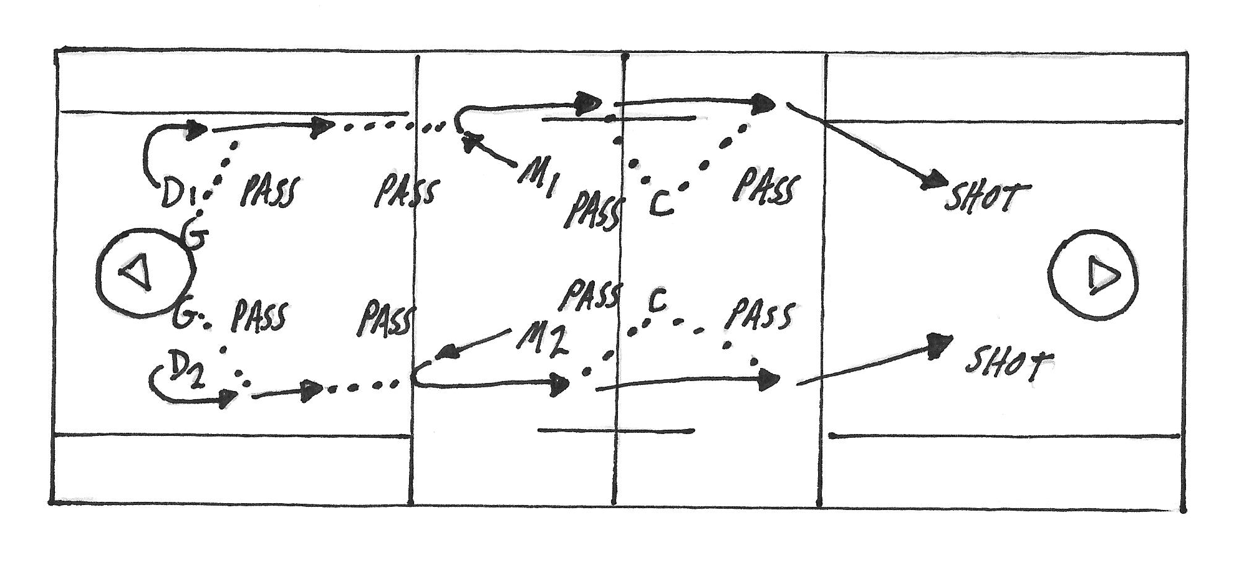
Goalie Outlet Passes to Player Passes
Tests: Passing, Catching, Conditioning
Explanation: Place two goalies on both sides of the goal and defenders a few yards from them (D1, D2). Have the goalies make saves from a teammate’s shot. Upon each save, the goalies yell “clear” and D1 and D2 cut to the toward the sidelines and up field. The goalies feed either D1 or D2, who should make a catch on the run with their outside hands. D1 and D2 then look up and feed two midfielders (M1 and M2) with passes on the run as well. M1 and M2 then look up and feed a coach just ahead of them. M1 and M2 sprint past this coach and each receives a return pass over their shoulder. M1 and M2 continue down their sides of the field and make shots on the far goal on the move. Shorten the field for younger ages. The focus here is on quick clearing and passing on the move.

Slide 15
Star Drill
Tests: Passing, Catching, Ball Movement
Explanation: Five lines in a star shape around the goal, about 15 yards apart, diagonally from one another. Have balls at each tip of the star for dropped passes. Player 1 starts, moving and passing to Player 2. Player 2 should be calling for the ball (i.e. “Here’s your help”), moving to the incoming pass (not waiting for it), catching and quickly passing to Player 3. And so it goes. Players follow their passes, moving through the star and to the next line in the star. Focus on constant motion and communication between players. If a ball is dropped or a bad pass made, quickly retrieve a ball from the start of one’s line. This is a good pre-game warm-up drill.
Variation: 1) Run clockwise and counterclockwise, using appropriate hands for passing. 2) Time the drill to see how many rotations can be completed in a minute or without dropping a pass. 3) Add multiple balls to the drill.
Something to Think About: Passes should be overhand and with proper hip and shoulder rotation. Players should run this loud, calling for the ball in plain English. This drill is often challenging and tempting for coaches to run “until it’s done right.” Run it for 10 to 15 minutes and MOVE ON. You can always come back to it. Kids don’t have the attention spans to run any drill for an entire practice.

Slide 16
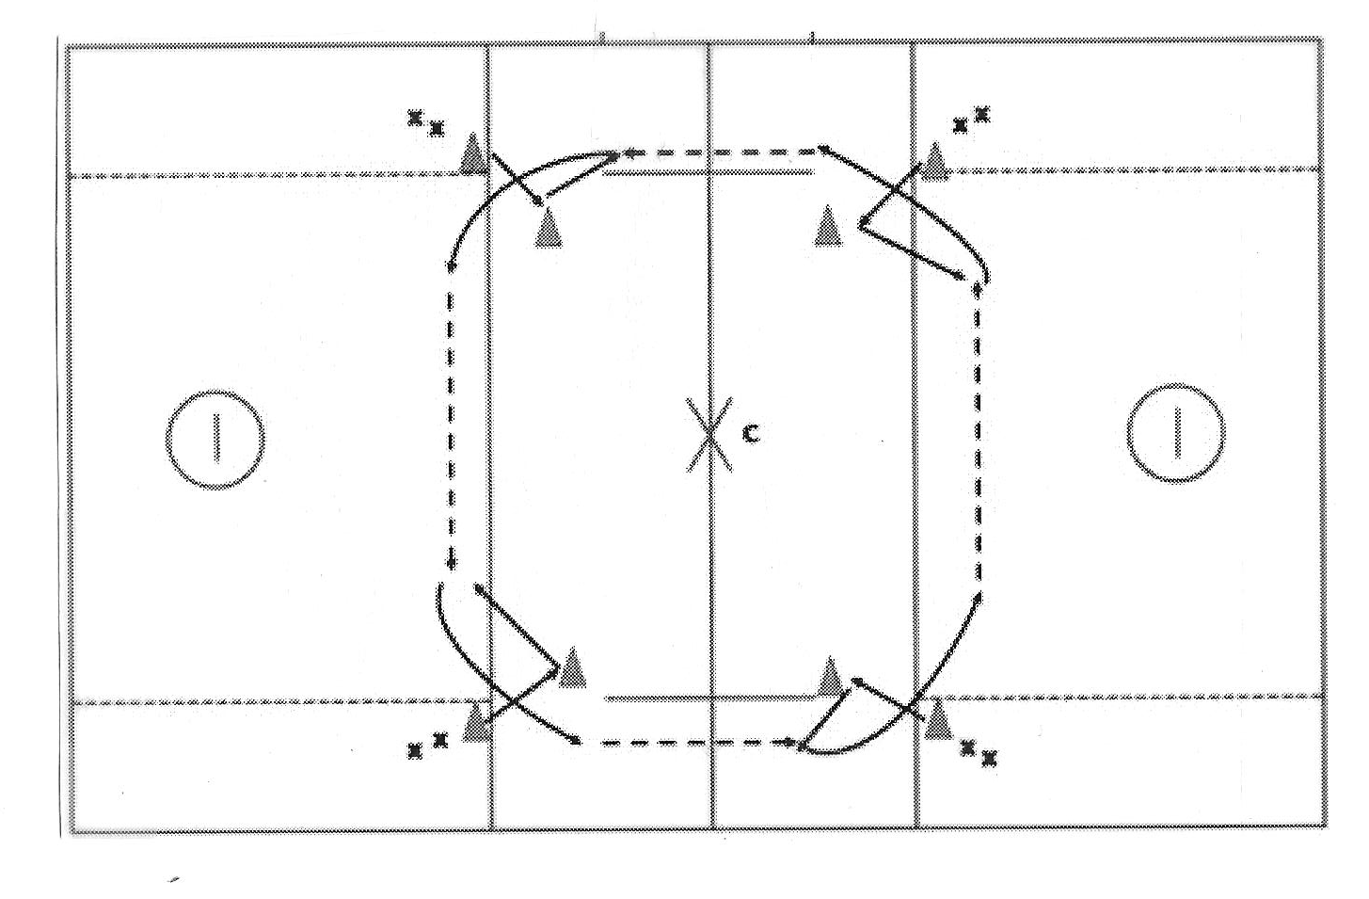
Four Corner Box Drill
Tests: Passing, Catching, Movement. (Simulates general flow of offensive game.)
Explanation: Place four cones about 20 yards apart to create an outer box (shorten for younger players). Place four more cones into a smaller box, five yards inside the outer box. Players are lined up on each outer cone. Coach is in the middle. The drill starts with Player 1 passing to Player 2. Player 2 will time his cut to his inside cone and receive a pass from Player 1. Player 2 will then catch, roll to the outside (switching hands), and pass to Player 3, who is copying these same movements. This drill can be run clockwise or counterclockwise. Extra balls should be at each cone for errant passes.
Something To Think About: Run this drill slowly at first. It looks complicated, but it’s the same basic movement repeated multiple times. It also acts as a simple way for an offense to move the ball. A coach can provide light defense to ensure that players protect the ball.

Slide 17
Basic Pick and Roll
Tests: Passing, Catching, Dodging, Field Vision
Explanation: Set up four cones around the attack zone, two cones up top and two on Goal Line Extended (GLE), about 10 yards from the crease. The ball starts at the Player 1 at GLE. Player 1 drives off his cone and accepts a timed pick from Player 2. (Player 1 should try to brush shoulders with Player 2.) Player 2 has to have his feet set, stick in tight to his body (not extended with his arms), and be still. Just as Player 1 is moving around the pick, Player 2 will release and move toward the goal. Player 1 will then pass to Player 2 for a shot. Two lines on the left and right side of the field will run this drill simultaneously.
Variation: 1) Vary the locations on the field where the pick will occur; 2) Add a token or actual defender so players can see spacing and timing.
Something to Think About: Once the general drill is understood, focus on timing and how critical it is to a proper pick. Add a defender to show how well it can work. If the defender follows the picking player (i.e. he knows what’s coming), have the ball handler attack the goal instead. The decision by the ball handler should make the defense pay and be focused on knowing that the offense has the advantage.

Slide 18
Give and Go Drill
Tests: Passing, Catching, Shooting, Ball Movement
Explanation: Have two lines of players at the top of the attack zone. One line will have balls and the other will not. Have a soft defensive player or a coach “guard” the Player 1 starting with the ball. Player 1 will pass the ball to Player 2 and then sprint toward the goal. The defensive player will follow the ball. Player 2 will catch the ball, switch hands, and throw a lead pass to the breaking Player 1. Player 1 should catch this return pass and shoot quickly.
Variation: 1) Vary locations on the field where this Give and Go will occur; 2) Run this as part of a transition play; 3) Have the soft defensive player play actual defense.
Something to Think About: As in the pick drill, if the defender follows the player without the ball (i.e. he knows what’s coming), have the ball handler attack the goal instead. The decision by the ball handler should make the defense pay and be focused on knowing that the offense has the advantage.

Slide 19
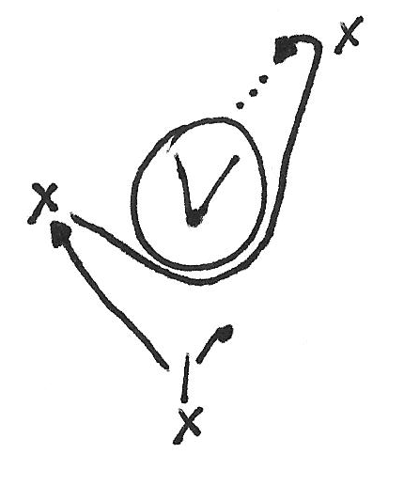
X Dodge Drill
Tests: Passing, Dodging, Shooting
Explanation: Players behind the goal (at “X”) will have a ball. A cone provides a marker for a starting point. Set up a cone to the left of the goal, about 3 yards off the crease. Set up a third cone on the other side of the crease, about five yards above and outside of Goal Line Extended (GLE). Have the players attack the first cone to the left at their full speed, plant their foot, turn and sprint around the back of the crease to the cone above GLE. At the cone above GLE, the player should shoot a 1) wrist shot from an inside roll, 2) a jump shot, or 3) execute a question mark dodge and shot. (Look the shots up on YouTube if you don’t know what they are.) This should be run quickly. Let players improvise with their dodges to test what works and what doesn’t .
Variation: 1) Switch the cones to the other side of the goal to work both hands and moving in both directions; 2) Add a defender working on pushing offensive players away from the goal; 3) Try the drill without balls at first to have players work on their bursts of speed.
Something to Think About: Coach players to have the confidence to know that however they are guarded by their defender, they can still make a shot. (Worst case, they roll away from pressure and pass to an outlet player…maintaining possession.) If their defender is behind, have them execute a rocker dodge. If their defender is equal, have them put their stick to the outside, step away to it, and shoot. If their defender is in front, roll under him for a wrist shot.

Slide 20
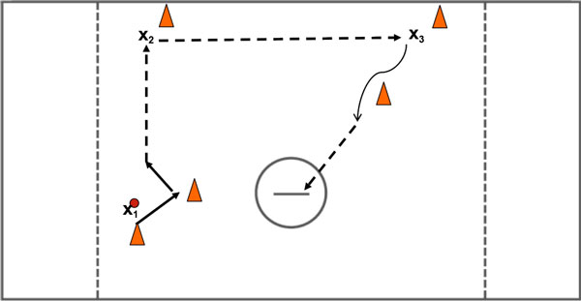
Hopkins Up and Over Drill (Courtesy of US Lacrosse and Johns Hopkins)
Tests: Passing, Catching, Feeding, Shooting
Explanation: Set up three lines with a cone in front of each line. One line (X1) will be three yards behind Goal Line Extended (GLE); one line (X2) will be directly in line at the top of the attack zone; and the final line (X3) will be at the top of the attack zone, but on the opposite side. Balls will begin at the bottom line, where that player will dodge inside, bounce out, and feed the ball to the first player in the top line. The top line player will catch, switch hands, and move the ball right away to the opposite side. The player at the opposite side will catch, drive off his cone toward the goal. Place a cone between this player and the goal for the shooting player to dodge, then shoot on the run (or time and room). Run this drill as quickly as the players can accurately pass. Rotate players through the drill locations.
Variation: 1) Run both directions for players to get reps using both hands; 2) Run starting high and ending low.

Slide 21
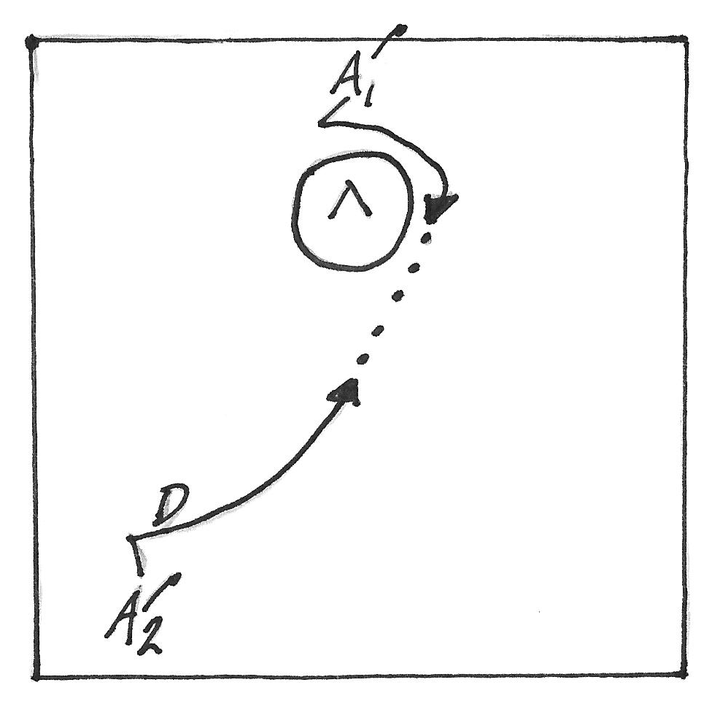
1v1 with Cuts and a Shot
Tests: Passing, Catching, Shooting
Explanation: A goalie is in the cage. Place a line of offensive players (A1) behind the cage at X. Place a line of offensive players (A2) up top, with a defender (D) guarding them. At the whistle, A1 will dodge from X. A2 will “V cut” (see diagram) at his defender and cut to the goal. A1 will feed A2 as he cuts to the goal with a pass; A2 will then shoot on goal with a quick wrist shot.
Error Correction: Players will have a hard time with the timing of their cuts and with the passes to a cutting player. Slow it down and work on this timing. Run the drill as fast as the players can handle the passing and catching. A1 making a good pass (even if it is dropped) should be praised.
Variations: 1) Run A2 on the same side as A1; 2) Start the ball from up top with A2. Have A2 “V cut” his defender and attack the goal. Have A1 sneak up to the far post for a passing option (i.e. a lay up); 3) Run two lines up top (w/ A2 and A3) and have them cross each other en route to the goal, where one will receive a pass from A1.

Slide 22
Hopkins Shooting (with Tennis Balls!)
Tests: Passing, Catching, Shooting
Explanation: A very simple and fun game. Three cones in an arch about 10 yards from the goal with offensive players at each cone (A1, A2, A3). Additional offensive players are in lines behind each cone. Two cones are behind each side of the goal with defensive players (D1, D2). Additional defensive players are lined behind each D1 and D2. A coach will feed tennis balls to one of the A players. On the feed, the D players will release and attempt to stop A from scoring. The A players can shoot or pass; all A players have to stay in the area of their cones. The trick is that any drops by A players have ALL A and D players exit the drill as fast (!) as possible. The coach then starts another round. The A players should rotate lines. Keep score! Run this as fast as possibly for three to five minutes and then switch A to D and D to A. Shooting should be with players’ inside hands.
Variation: 1) Have two coaches with balls at different areas of the field to give players different looks.
A Little Something Extra: Players often avoid shooting at the line where they have to use their non-dominant hand. Force them to go through all lines. Count these goals double to incentivize kids shooting with both hands.

Slide 23
Aim Small, Miss Small (Shooting Accuracy Drill)
Tests: Shooting
Explanation: Place two lines of players around five to seven yards from the goal. Both lines should be at 45 degree angles from their near pipe. First players in each line should have their backs to the goal, chests and sticks pointed toward midfield. Lots of balls are at each line’s feet. On the whistle, players will pivot to the goal and shoot with their outside hand as hard as possible to their far pipe. Try to have players aiming for about 18” inside the far pipe and 18” off the ground. This gives them room to miss.
Error Correction: Players will miss at the beginning. This is okay. Work with players on form and not over shooting. The drill is meant to have players dial in their accuracy. Shoot overhand!
Variations: 1) Have players pivot to the inside; 2) Coach selects where players will shoot on the goal; 3) Have two groups go and keep score in a timed event; 4) Use tennis balls to work on form.

Slide 24
Dodging and Shooting
Tests: Dodging, Shooting, Defense
Explanation: Place a defender (D) and an offensive player (A) on each side of the goal, separated by five to seven yards. A coach is in the middle and will feed each offensive player with passes. At each pass, the corresponding D will come at A, easy at first. Offensive players should practice dodges on catches, with a defender coming at them. Here are a few to try: 1) If D comes at A quickly, A catches and hitches; cuts to the inside for a shot past the defender; 2) If D approaches A and is in A’s shooting lane, have A face dodge, and run at the near pipe for a shot; 3) if D is too close or A is reacting to a bad pass, A can toe drag (or a fake toe drag), coming under D’s stick, run at the near pipe and take a shot. Have players try their own shots. The point is to dodge, maintain one’s balance, and shoot quickly.
Error Correction: Watch that A is running at the near pipe with a purpose and NOT fading away from it. Some offensive players will subtly curl away from the goal. Make this direct and simple: Go at the near pipe.
Variations: 1) Use tennis balls to work on soft hands, and, especially if you use a goalie for this drill.

Slide 25
Slow Breaks to Trailer Shots
Tests: Passing, Catching, Shooting
Explanation: Two lines of players, one on each side of the Attack Zone. Make a large “V” cones from the goal. This will keep players on their side of the field. The first player in line with scoop a ground ball or catch a pass from a coach and run at the goal, with the ball in his outside hand. At around 10 yards from the goal, the coach will yell a key word (like “pressure”) and this player will simulate defensive pressure on him. He will put his stick to the outside and switch hands following his stick to the outside, rolling away from pressure. As this player is rolling to the outside, the second player in line will cut to the goal, calling for the ball. The first player will feed the second player who will take a quick shot. This simulates a transition play.
Variation: 1) Put a defensive player into the drill on each side of the cones.

Slide 26
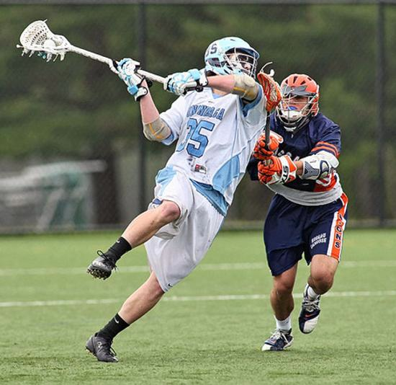
Shooting Lay-Ups (or Jump Shots)
Tests: Shooting
Explanation: A line of players positioned around five to seven yards in front of the goal (move back if this is too easy). The first player in line will scoop a ground ball at his feet, take two steps to the outside (or inside), raise up on his inside leg and shoot the ball as hard as possible into the goal. Have players in line alternate sides and shooting hands. As players get the hang of this, a coach can call locations for the shot.
Variation: 1) Add feeders on each side of Goal Line Extended (GLE) to feed the shooter. Have this same shooter shoot twice, once going each direction (and using each hand); 2) If possible, extend the shooting range.

Slide 27
Jackson’s Shooting On The Move
Tests: Shooting, Passing, Catching, Conditioning
Explanation: Place seven cones on the field: Three cones around five yards apart on each side of the goal and a cone at X. A1 will start in the middle at the cones furthest from the goal. On the whistle, A1 selects a side (say right) and will cut around the first cone, call (or signal) for a pass, and a coach will feed the ball. A1 will catch the pass and take a time and room shot. A1 then runs around the middle cone, receives a pass and takes a jump shot. A1 then runs around the cone closest to the goal, receives a pass, fakes low and takes a wrists shot high. All shots should be taken with A1’s inside hand. Another shooter (A2) then runs the same drill, but from the left side. Run this fast and have all players rotate positions. Coaches want their players tiring during the drill to focus them on form and decision making when fatigued. This is a drill for players to run themselves.
Variation: 1) After A1 and A2 have gone, have A3 and A4 run the drill in the opposite order (i.e. around the cone closest to the goal first), coming from X (wrist shot to jump shot to time and room shot). Have all players run through all rotations.

Slide 28
Attack!
Tests: Shooting form, Conditioning
Explanation: Place two arcs of cones with an open area of about seven yards between them. Divide team into two elements. Put goals to around 15 yards from each team’s arc. Place as many tennis balls as possible behind each team’s goal. All players prone on their arc to start. At the whistle, players rise up, run to their ball supply, and play dodge ball for three minutes. Players hit with a ball run out and do 15 mountain climbers. Players catching a ball release a teammate from the “out” area. Players scoring a goal get a point. No stepping into “No Man’s Land” or a player is out. Coaches can call “jail break” as often as they like.
Variation: 1) Alter the field to different shapes and put pockets of players in different areas; 2) Add goalies.
Error Correction: At first, virtually all players will over shoot the ball in this drill. This is a good thing as it will allow coaches to correct form and to demonstrate proper shooting technique. When players are getting their breath back after a round, show them and let them practice a few throws with proper form before starting another round. Kids see a direct improvement with this teaching.

Slide 29
Defensive Grids 1v1s
Tests: Defensive Positioning (w/ age appropriate contact), Offensive Dodging, Ball Handling
Explanation: Construct three 10 yard x 10 yard grids and put a defender (D) in each grid. Offensive players (A) are at the top of the drill. On the whistle, A players have to navigate through the grids to an open grid (Open) for a shot. Have players alternate roles and, if possible, run more than a line at a time. Run this drill from both up top attacking the goal and behind the goal around X. This way it works D and A from different spots on the field.
Variation: 1) Consider having D play without sticks at the beginning to practice footwork and legal pushes; 2) Split elements into two “team” and time how many goals can be scored in three minutes, then switch roles.

Slide 30
Irish Channel
Tests: Defensive Pressure, Offensive protection of the ball.
Explanation: Make a rectangle with cones, approximately 15 yards long and 7 yards wide. Start at one end of the rectangle with an offensive player (A). A defensive player (D) will be approximately three yards inside the drill. At first, have A and D play without a sticks. At the whistle, A will attempt to get from one end of the rectangle to the other. D may push or block A, especially pushing A out of bounds. If A is pushed out of bounds, A restarts from where he was pushed out. Slow this down to ensure that proper technique is being used. There should be NO crashing into players. A has to reach a cone at the end of the rectangle and touch it to end the drill.
Variations: 1) Have A play with his stick and no ball; 2) Have A play with his stick and a ball. Keep D without sticks to work on footwork.
Error Correction: 1) Many defensive players fail to move their feet and are beaten on the first move, ensure that defensive players are moving their feet and keeping their bodies between their man and the goal (the cone at the end); 2) Many offensive players stop moving after initial contact with their defender, ensure offensive players are constantly moving, looking for daylight, dodging (rolls and changes of direction), moving at constantly changing 45 degree angles across their defender (i.e. forcing their defender to readjust his feet).

Slide 31
Touch The Cone
Tests: Defensive Pressure, Offensive and Defensive Play, , Passing, Catching
Explanation: A coach has a ball and teams are divided up at multiple spots on the field. There is a cone somewhere in the center of the field and all players have their backs turned toward the cone. A coach will move the cone between reps. A coach will designate an offensive player (A) and a defensive player (D). On the whistle, D will turn around, sprint to and touch the cone. As this is happening, the coach will pass a ball either to A (a pass) or to an area near A (a ground ball). Next, A will possess the ball and try to score. D will recover and play defense. Have all players go on offense and defense, then switch. Keep score.
Variation: 1) Designate multiple players to go for each ball (e.g. 2 v 2 or 3 v 3).

Slide 32
1v1 Ground Balls in Offensive Zone to 3 v 2
Tests: Ground Balls, Offensive and Defensive Play
Explanation: A coach softly rolls a ball to the 1v1 players at an area on the field. Upon possession, the “winning” offensive player (A) enters the drills; the “losing” offensive player gets back in line. Upon possession, two defensive players (D) and and two offensive players (A) immediately enter the drill from different areas of the field, creating a 3v2. Work on players going “ground ball, pass, pass” to move the ball. Run this very quickly, like under 20 seconds per rep. If defenders win the ball at any point, have them clear it and have offensive players ride them until told to stop.
Variations: 1) Start the 1v1 ground balls at X or in the alley or at a corner of the field, vary it to keep the players interested; 2) Vary the locations of the awaiting offensive and defensive players to give them each different looks.

Slide 33
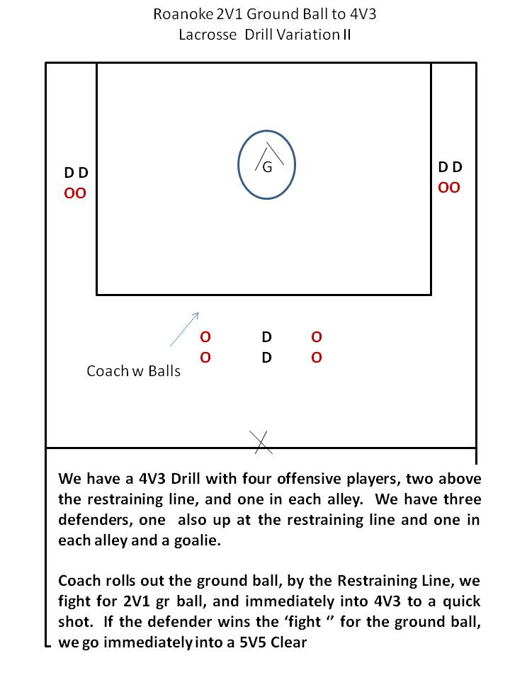
2v1 Ground Balls in Offensive Zone
Tests: Ground Balls, Offensive and Defensive Play
Explanation: Self-explanatory. For older ages, focus on “Man Ball” play where O helps each other. One “O” player calls “Man” and legally blocks or checks “D.” One “O” player calls “Ball” and takes possession. Upon possession, the ball carrier should call “Release” as a signal to his partner to end contact with “D” and to immediately move to open space for a pass. As in other drills, work on quick passing.
Variants: Move the 2v1 element to different areas of the field.

Slide 34
Four corner shooting
Tests: Ground Balls, Shooting, Conditioning.
Explanation: A coach rolls a ball to a player at one of the cones. This player scoops the ball and goes to the goal for a shot. After shooting, this player will sprint to a new line. This drill is meant to be run quickly. Encourage the players to get tired and to test themselves. Give players five seconds to shoot to ensure that they are hustling.
Variations: 1) Add one or two lose defenders to force the shooters to react; 2) Play with tennis balls and put a goalie in the cage to practice.

Slide 35
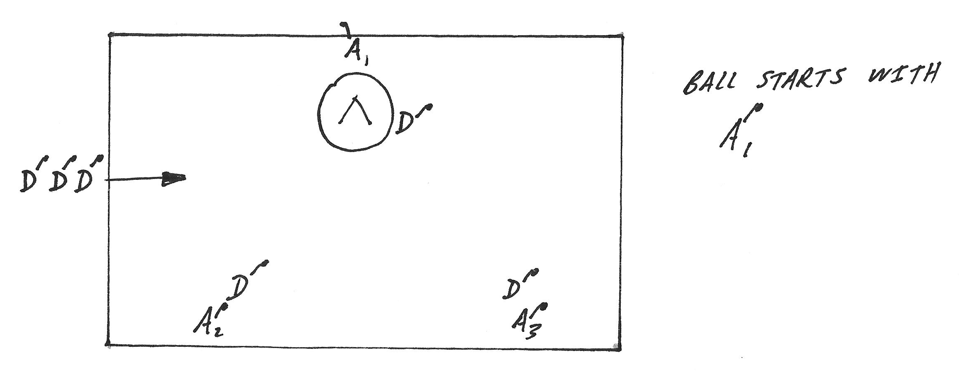
1v1 With Simple Slide
Tests: Defense, Dodging, Simple Slide, Communication.
Explanation: Have a line of offense (A) and a line of defense (D) at the top of the attack box and behind at X.
Have a next defender (D) off to one side. On the whistle, have one of the A lines go 1v1 with their D line. The defender from the side will run into the middle of the field and prepare to help his counterpart. The coach will call “Slide!” and the extra defender will come to support. If there is no call, the extra defender stays in the middle, ready, stick up. Rotate the players around and vary the starting locations.
Variations: 1) Add and offensive player in front of the goal to complicate the defenders’ situation. Allow A to pass to this new offensive player for a quick shot.

Slide 36
2 v 1 Inside or 2 v 1 Outside
Tests: Passing, Shooting, Communication.
Explanation: In a limited area, have players play 2 v 1 to a shot or defensive stop. Defenders (D) pushing the offensive players (A) over the coned area or into the crease should be rewarded with a defensive stop. 2 v 1 Inside focuses on close in shooting; 2 v 1 Outside focuses on outside shooting. Put each rep under a time limit and stop the drill if A players are not working together to get an open pass or shot. Run quickly and rotate players.
Variations: 1) Run this Inside and Outside as part of the same drill; Inside goes to whistle, stop, or goal and Outside goes immediately afterwards; 2) Add a goalie.

Slide 37
2v1 In Five Minutes (Courtesy of Lax Coach Mike)
Tests: Passing, Shooting, Defense.
Explanation: Have a coach up top of the offensive zone with players split into two lines on each side of the field. Start with a defensive player (W) in front of the goal. Coach throws a pass or rolls a ground ball to one side and two players enter (B). Both B players play 2 v 1 very quickly to a shot, stop, save, or turnover. When the rep ends, W runs off to his side. B players become defenders; B who touched the ball last has to sprint to the coach and exit the drill; the other B stays in the middle becoming the lone defender. Coach throws a pass or rolls a ground ball to the W of players, who enter to a 2 v 1 scenario. And so it goes…
Variations: 1) At the end of the first rep, the player who touched the ball last sprints to the coach and off the drill. Coaches can have that player reenter the drill. This way the drill starts with a 2 v 1 for a few seconds and then becomes a 2 v 2.

Slide 38
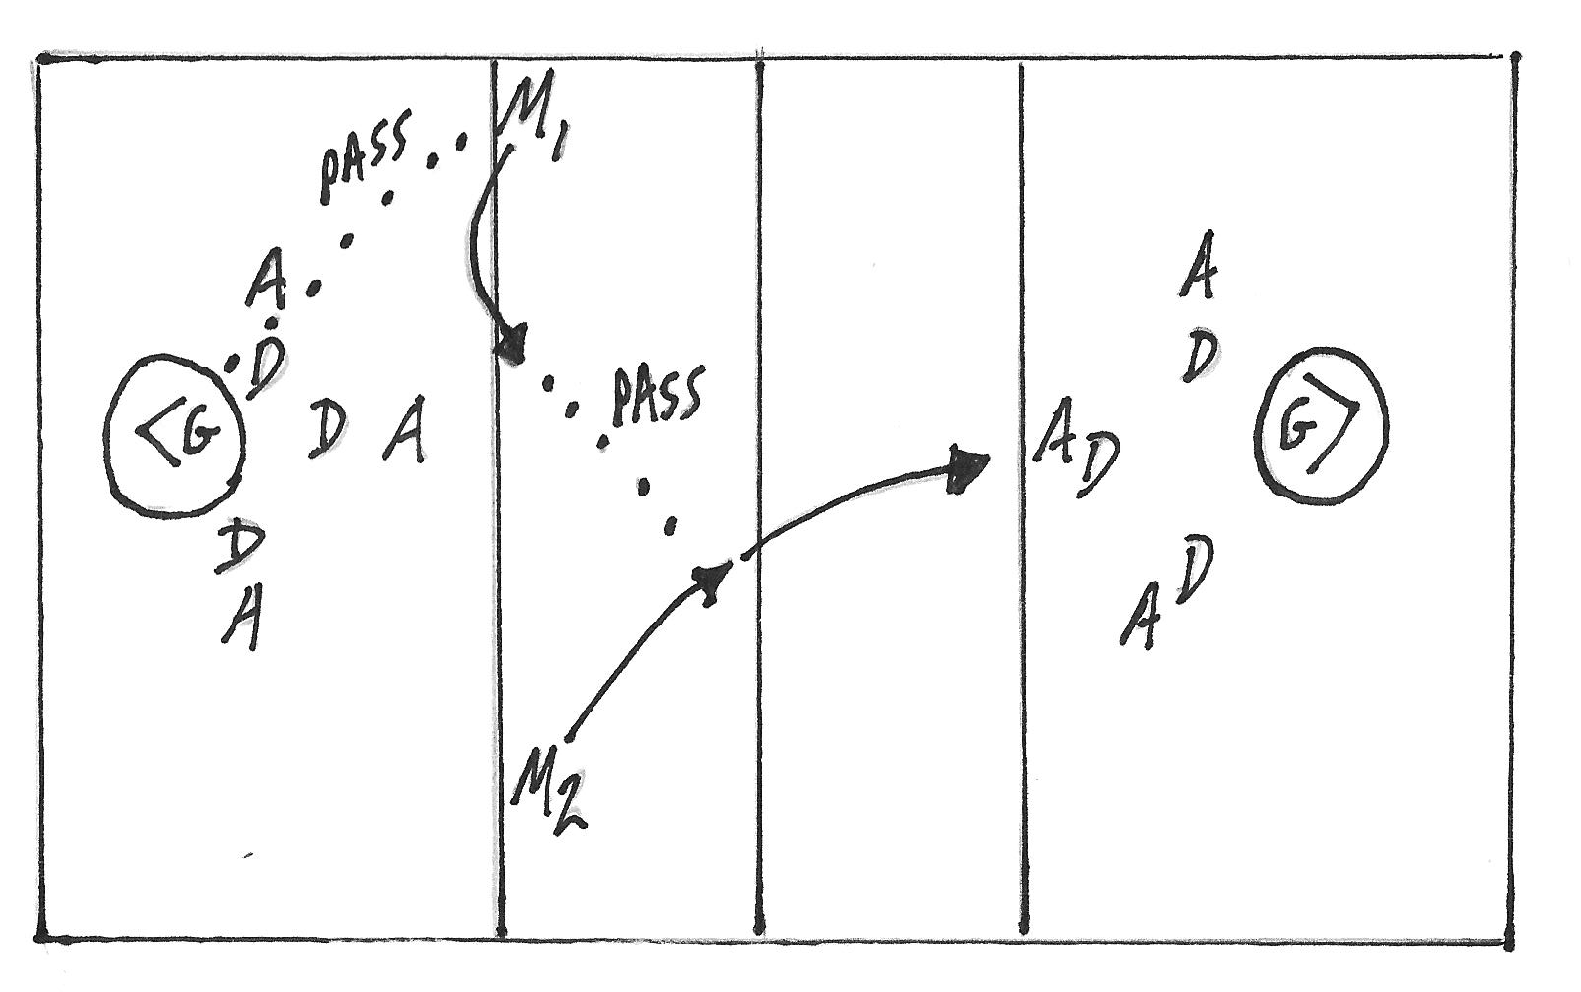
4 v 3 Clears
Tests: Transition Offense, Clearing, Passing, Defense
Explanation: Place a goalie, three attack and three defenders on each side of the field. Place the rest of the players around both sides of the midfield. On the whistle, the goalie from one side will clear the ball to M1, who will cut across the top of the restraining box. As M1 catches the ball, he will immediately look feed a cutting M2, on the opposite side of the field. M2 will then fast break to the other side, creating a 4 v 3. M1 then acts as a defender and chases M2 to see if he can stop him. On a shot, clear, or save, run the drill the same way the other direction. Force players to run this drill fast.
Variations: 1) If not too chaotic, run both directions of the drill at the same time.
Something To Think About: If the fast break really is coming at the defense, discuss with them how they will handle it, slide to it, etc. Simple rule of thumb is to force the fast breaking player to the outside. Savvy defenders will realize that most youth players are right handed and forcing them left slows a fast break quickly.

Slide 39
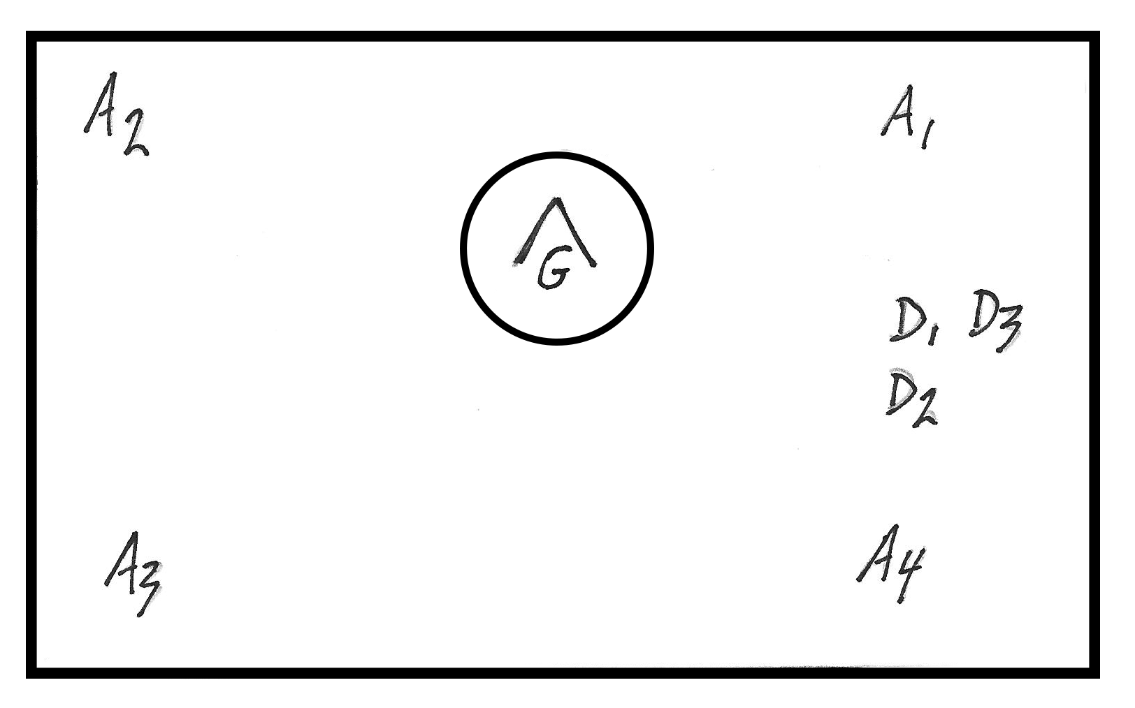
4 v 3 With Disadvantaged Defense
Tests: Defense, Offense, Communication.
Explanation: Offensive players (A1, A2, A3, A4) all cradle a ball in their lines. Defensive players (D1, D2, D3) are together in one area of the field, disadvantaged by being in a group off the ball. A coach will call an offensive player; the other three offensive players drop their balls; all four offensive players run around their cones and into the drill. Defensive players sprint in from their area. Plays goes to a score, save, or turnover. On a save, work on clears; on a turnover, have defensive players clear the ball to the midline. Run this fast, like under 15-20 seconds and have players in line ready to go as the next group. All players rotate positions. Run five to seven minutes with one group on offense and one group on defense and then switch roles.
Variations: 1) Alter the starting locations of all players.

Slide 40
Patton Drill (Courtesy of US Lacrosse)
Tests: Ground Balls, Offense ,Defense.
Explanation: Split players into two teams. Put two (or three or four) players from each team in the drill. A coach throws a ball onto the field as a contested ground ball. The player who wins the ground ball gets an additional teammate to come in from up top, creating an immediate advantage. The drill goes until a score or a clear. Have defenders clear all turnovers.
Variations: 1) Vary the players’ starting locations.

Slide 41
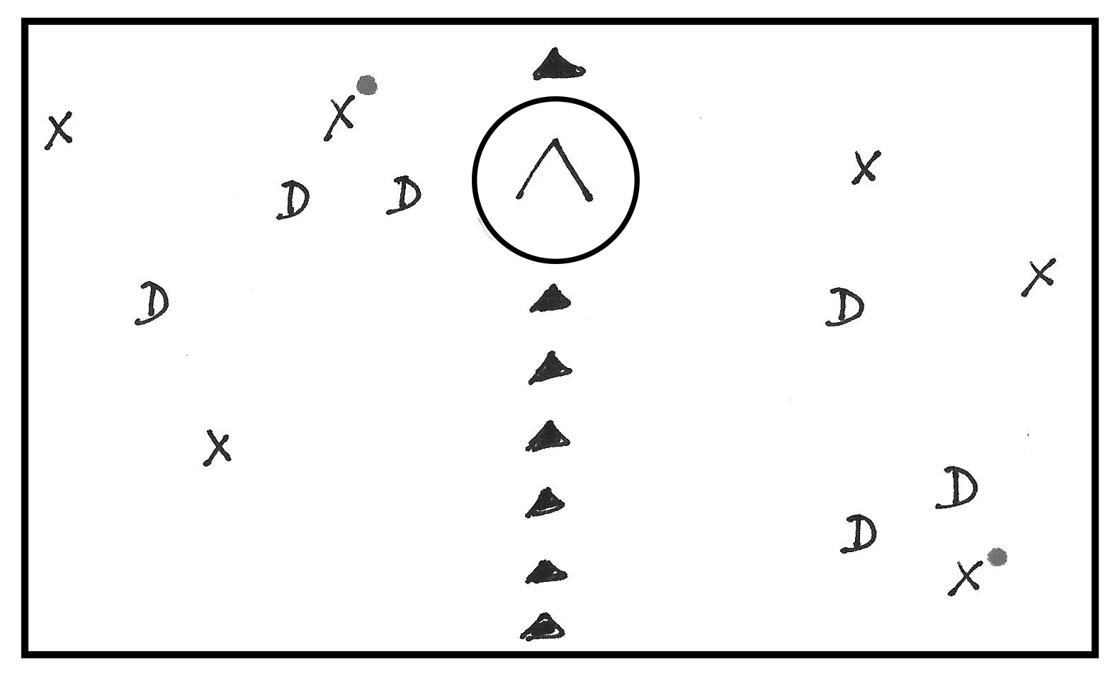
US Drill (Courtesy of US Lacrosse)
Tests: Double Team Defense, Communication, Passing.
Explanation: Split the attack zone in half with cones and set up two 3 v 3s (X and D) on each side of the cones. Start the drill with a player on one side holding the ball down low and a player on one side holding the ball up high. Both players holding the ball are double teamed by defenders. At the whistle, players will play to a score, save, or turnover. Have defensive players clear all turnovers. Offensive players need to move to open space to relieve pressure from their double teamed teammate. All players need to communicate.
Variations: 1) Add and offensive player in front of the goal to complicate the defenders’ situation. Allow A to pass to this new offensive player for a quick shot.
A Little Something Extra: Get players talking and supporting one another, even in this tight space.

Slide 42
Standard 4 v 3 Drills (or 5 v 4 or 6 v 5) or Even Drills (4 v 4, 5 v 5, 6 v 6)
Tests: Offense, Defense, Passing, Ball Movement, Shooting, Dodging, Simple Slides, Communication.
Explanation: Any number of variants exist. Consider having players start from fixed locations (below) or unsettled positions (your creation); have some defenders set around the goal and some defenders entering from different spots on the attack zone. Play to a goal, save, clear, or whistle. Have defense clear all turnovers; have goalies clear all saves.
Variations: 1) Switch the numbers and go 3 offense and 4 defense (or 4 offense and 5 defense); 2) These are disadvantage games. Also try running straight 5 v 5 or 6 v 6 drills to work on slower movement of the ball, especially over a half of the field.

Slide 43
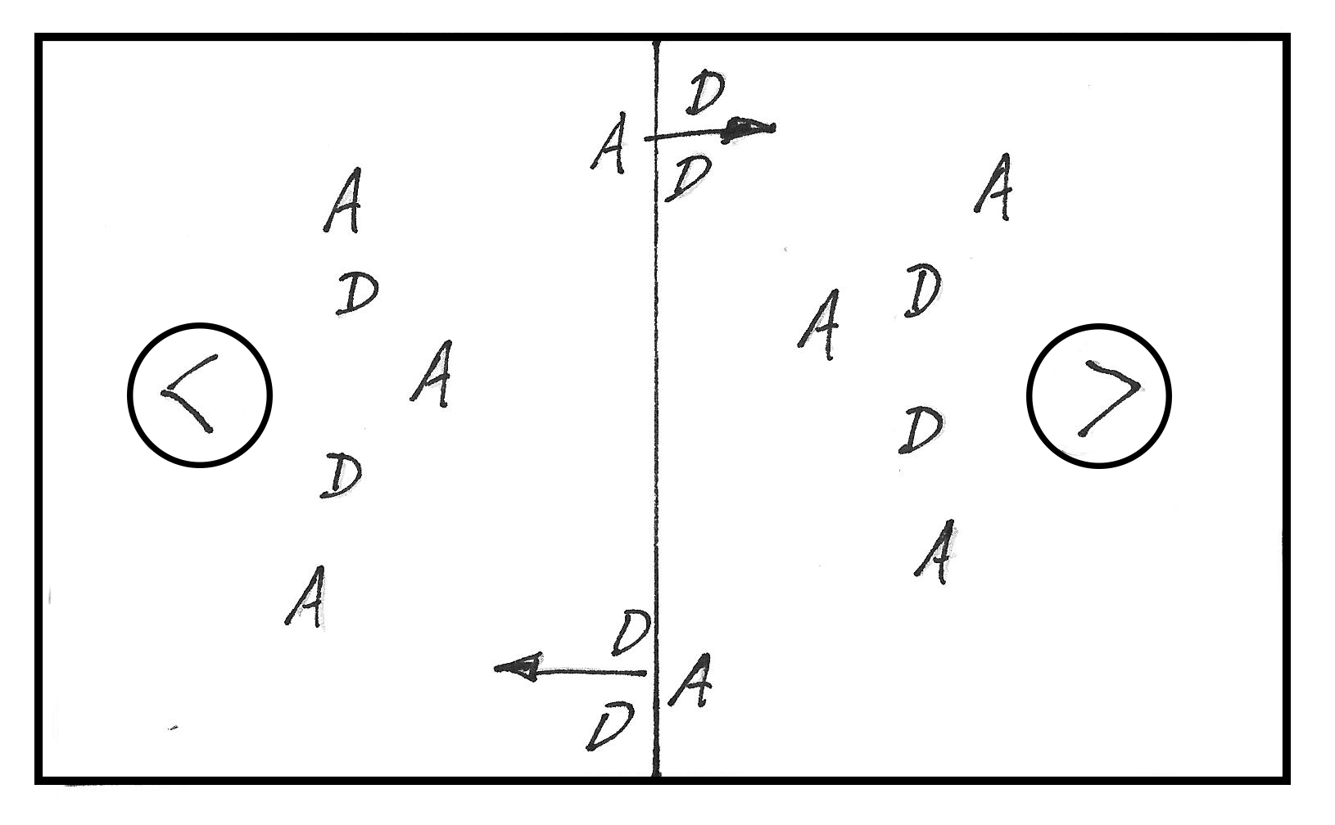
Double Teams on a Dead Ball
Tests: Defensive Intensity, Offensive movement, Passing, Dodging.
Explanation: Have three offensive players (A) and two defensive players (D) around each goal. Have one offensive player (A) somewhere around the midline with the ball and guarded by two defenders (D); mirror the same thing on the other side of the midline. On the whistle, one of the double teamed players will try to beat his double team and go one direction to the goal; the other double teamed player will do the same and go to the other goal. Play to a score, save, or turnover. Have all saves and turnovers cleared.
Variations: 1) Put four offensive players around the goal and three defensive players; 2) Play with tennis balls.
A Little Something Extra: A great way to force turnovers is to double team ball carriers on dead balls, especially on the corners of the attack zone or on the sides of the field. Teammates of the double teamed player need to move to help him, made easier if they form a large triangle to give him passing options out of the double team.

Slide 44
1 v 1 Ground Balls to Fast Break
Tests: Ground Balls, Passing, Transition Offense, Defense.
Explanation: Use the full field. Place offensive (A) and defensive (D) players at one end of the field. (Below is 3 A and 3 D, but you can place 4 A and 4 D or 5 A and 5 D.) Place two players (A1, A2) on the corner of what would be their defensive zone. A coach rolls a ground ball and A1 and A2 fight for it. The winner, looks up, and passes to an entering A3 at the midline as fast as possible. A3 then runs the ball in to his attacking zone for a 4 v 3 (or 5 v 4 or 6 v 5). Play to a shot, save, or turnover. Clear all saves and turnovers to the midline. Rotate players. Have the losing ground ball player (either A1 or A2) stay for another round. This drill simulates a transition game and starts players thinking “ground ball, pass, pass.”
Variations: 1) If you have enough players run this drill going both directions; 2) Have the losing ground ball player count to five or do a physical exercise and then sprint to catch up (i.e making that 4 v 3 a 4 v 4).

Slide 45
Little Bacon
Tests: Everything and Conditioning.
Explanation: Play half field, two goals are placed with enough room to allow for space behind them. Put a coned starting area around that field’s midline and split the team in half. Count off each player with a number (e.g. 1, 2, 3, 4, 5, 6). A coach with a ball, calls a number or series of numbers (e.g. “ 5s,” or “1, 3, 4 ” or “evens”) and those players sprint around the goal they are defending and into the game; their counterparts do the same on their side. While they are running, a coach throws a ball to one side or another. Those players then play to a goal, a ball out of bounds, or a whistle (i.e. they took too long). Players run back in line and coach starts a new rep. Run this very quickly. Kids love it. Keep score.
A Little Something Extra: A coach should tell players before the game starts that he (or she) is not going to be fair and that some balls will be thrown toward a particular side to encourage different looks. Adapt to the unfairness.

Slide 46
Genny’s (West Genesee), A Classic
Tests: Everything and Conditioning.
Explanation: Cut the field in half for younger aged players; Run full or ¾ fields for older aged players. Place half the team at one end line and half at the other end line. This is a constant 3 v 2 drill. Three offensive players (A1, A2, A3) race down the field with a ball. Two defenders (D1, D2) are awaiting them at the other end and communicating LOUDLY about how they are going to guard the threat before them. A very quick 3 v 2 takes place. Upon a shot, errant pass, or loose ball three things happen: 1) The LAST offensive player to touch the ball sprints back to his line and out of the drill; 2) The remaining two offensive players become defenders and sprint back to defend their goal; and 3) the two defensive players from the past rep become offensive players, the next player in their line joins them to make three offensive players. Play with goalies if feasible. Keep score.
A Little Something Extra: Force players to pass. Force defensive communication and movement. This drill is tempting to run until the players are exhausted. Keep it under 15 minutes and try another drill. You can always come back to this another practice. Consider having dropped passes end a rep for older players.

Slide 47
Scramble and Chaos
Tests: Everything and Conditioning.
Explanation: Split the team in half (A and B) and put all players along the midline. A coach will be in the center of both split teams. A coach will call for a number of players (e.g. “4”) and the first four A and B players will enter the drill on one half to a ground ball or a pass and play to a goal or turnover. (Clear all turnovers.) A coach will then call for a number of players (e.g. “3”) and the first three A and B players will enter the drill on the other half. The drill continues with constant rotations. Upon exiting the drill, players go to the back of their respective lines. Keep score.
A Little Something Extra: Remind your players that you want them tired and testing themselves and their decisions. This is growth. Also tell them that you will not always be fair where you throw the ground ball.

Slide 48
Numbers
Tests: Everything and Conditioning.
Explanation: Play on half the field. Split the team in half (A and B). Place A and B along two of the four lines of the half field (the midline, both sidelines, the endline). A coach will designate an offensive team and a defensive team. A coach will call a number, say “4,” and four offensive players will enter the drill to a pass or a ground ball from the coach. The defensive team will also enter, but with one less player (i.e. “3” in this case). Both teams play to a goal, a turnover, or a coach’s whistle. Have the players moving the ball quickly and paying attention to where they are in line. Switch locations of A and B to give different looks and switch offenses and defenses. Use a goalie. Work on the simple offensive and defensive sets listed below.
Variations: 1) Switch the advantage to the defense. Saying “4” is four defensive players and “3” offensive players.

Slide 49
Syracuse
Tests: Everything and Conditioning.
Explanation: Repeated 3 v 2s on a half field. Put multiple groups of five players in alternating colors (N and W) on any of the sides of the field. Coach tosses a ball to one of the these sides and players play a 3 v 2 to a goal, turnover, or save. Defense wins by clearing a turnover or by dropping it into the crease area (for a goalie). Play this fast and then run it from another side. Run for time and then switch which side as the advantage. Play with a goalie and keep score.
Variations: 1) Confine the field further to force closer passes and direct movement.

Slide 50
Scrimmages (and not so typical scrimmages)
Tests: Everything, but scrimmages can be limiting to newer players so be on guard.
Explanation: A well organized coach has game simulating drills, which can act like mini-scrimmages, where players get touches and multiple looks. That said, players also love scrimmages, which they equate them to the actual game. Play scrimmages every so often, but not every practice. For younger ages shorten the field, place the goals inside both sidelines and play two 6 v 6 scrimmages on half a field. For older ages, think about throwing in variations on the fly to test players (e.g. “three passes before a shot” or “double team the ball carrier”). Focus on the fundamentals: passing; catching; ground balls; supporting each other on offense and defense and communicating; man defense; riding; goalie clears; etc. Work on the little things as well: double teaming on dead balls; substitutes on the fly; face-offs and hustling in from the wings; keeping the ball in the box on offense; man up/man down plays, etc.
Add Ons: 1) Call a time-out, have players sprint to the sidelines and quickly direct them to something new or let them try to set up something themselves; 2) Give the players a half time with either a) coach directions or b) putting a player in charge; 3) Call a “short time” play, tell them that they have “15 seconds!” to score before the horn.
Scrimmage Getting Boring? 1) Give players five seconds to pass or it’s a turnover…teammates better be supporting; 2) Any personal fouls have the fouling player going to a “circle of shame” or to exercise for the duration of his penalty; 3) Give players 20 seconds to get the ball into their attack zone or it’s a turnover; 4) Come up with your own wrinkles.

